Slide 1
LabVIEW DataGrid
An open source project to replace LabVIEW’s Table
Presenter: Mike King
Contact: unipsycho@gmail.com

Slide 2

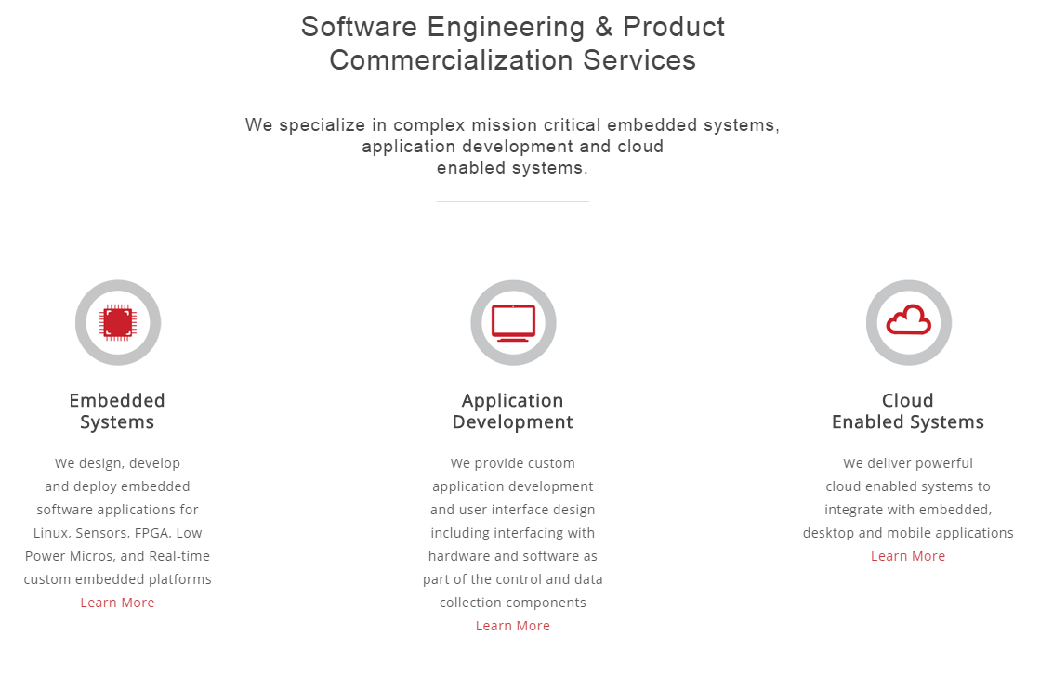
About Mike
Mike’s currently working for Prolucid
Led and built teams & innovation within product development groups
Technical expertise in LabVIEW, C# and Web systems for over 15 years
Architected platforms in instrumentation, controls and automation
System integration of LabVIEW with web tools, HTML, and Database Systems

Slide 3
Project Reason and Purpose
LabVIEW’s Tables are very limited
DataGrids are a proven excellent solution for tabular data
.NET has a great DataGridView component
.NET containers in LabVIEW are fast and integrate well
Purpose is to therefore, provide a LabVIEW Table replacement with more capabilities that is much easier to use (by both developers and end users) than the native table.

Slide 4
LabVIEW Tables
Forced to Implement Manually
Additional cell data types
No word wrapping
Auto column resizing
Cell text wrapping
Column sorts and filters
All these are native to .Net DataGridView, no custom programming

Slide 5
What is DataGridView
A .Net control that provides a powerful and flexible way to display data in a tabular format.
Variable from simple read only to massive editable complex datasets
It’s common to all UI frameworks in all languages except LabVIEW
It uses additional .Net objects for it’s data and configuration
LabVIEW DataGrid makes use of this in LabVIEW with wrapper classes and objects to make data input and configuration of the grid simple

Slide 6
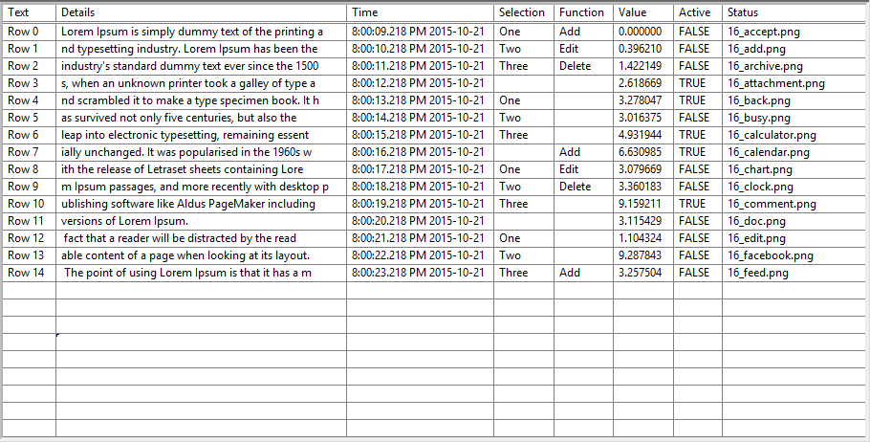
Lets Turn This Typical LabVIEW Table

Slide 7
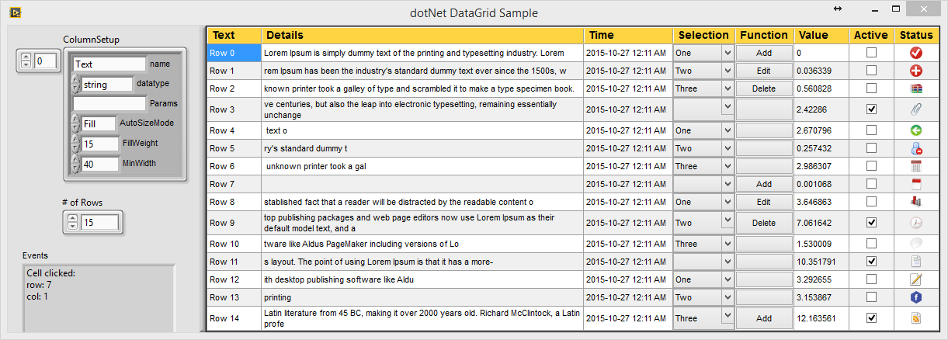
Into a more functional DataGridView

Slide 8
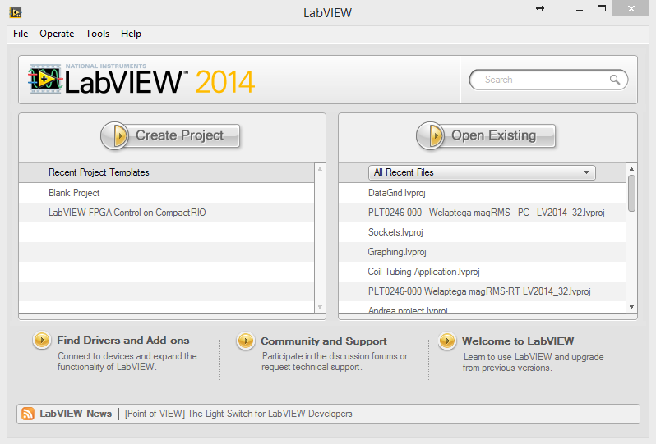
Demo the DataGridView

Slide 9
.NET Classes Implemented
DataGridView
GridColumn
CellStyle
Color
Font
DataTable

Slide 10
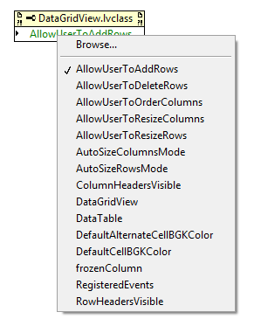
DataGridView Properties
Many basic features and properties are working
Adjustments and editing
Visibility
Colors (Separate Class)
Cell Styles (Separate Class)

Slide 11
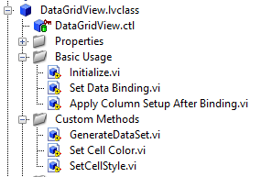

DataGridView Methods
Top level Helpers will make DataGridView simple to use, even for beginners in LabVIEW
Basic methods will be made to replicate LabVIEW common table methods
Advanced methods will enable and configure extra features
.net methods can be used directly as well

Slide 12
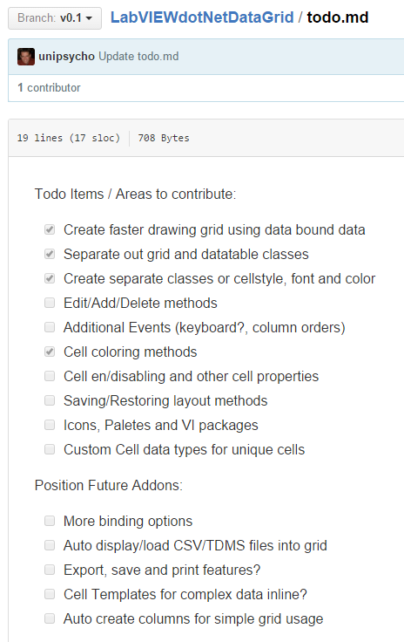
Ways to contribute
Download the GridView and use it, give feedback
Contribute ideas, issues, and documentation
Contribute code enhancements, features
View the Github project’s Todo.md file for more areas to contribute

Slide 13
Contacting Mike
Find him on NI’s forums, user ‘Mike_King’
Email him at unipsycho@gmail.com
Github: http://github.com/unipsycho
@Prolucid: mike.king@prolucid.ca

Slide 14
Resources
GitHub Source Code
https://github.com/unipsycho/LabVIEWdotNetDataGrid
Discussion Forums
http://forums.ni.com/t5/LabVIEW/OpenSource-Project-for-a-NET-Datagrid-for-LabVIEW/m-p/3205078#M929642
https://lavag.org/topic/19274-full-datagridview-for-labview-open-source-project-underway/

